Slide 1


2403 PT_DS | Regression Project Kick-Off

Slide 2
01.
Introduction
02.
Project Workflow
03.
Conclusion

Slide 3
Introduction
Project Objectives
Educational Goal
Introduction to practical applications of Regression Analysis in Python focusing on forecasting average temperature in Agriculture
Project Goal
Kick-Start the 6 Week Team project.
Apply learned concepts and technical skills to a live dataset.
Collaborative Goal
Build on the use of collaborative tools introduced Python and expand on those tools to include: Trello for project management.
Final Outcome
Ability to deliver comprehensive analysis and presentation of findings, demonstrating technical and competence and team work.

Slide 4
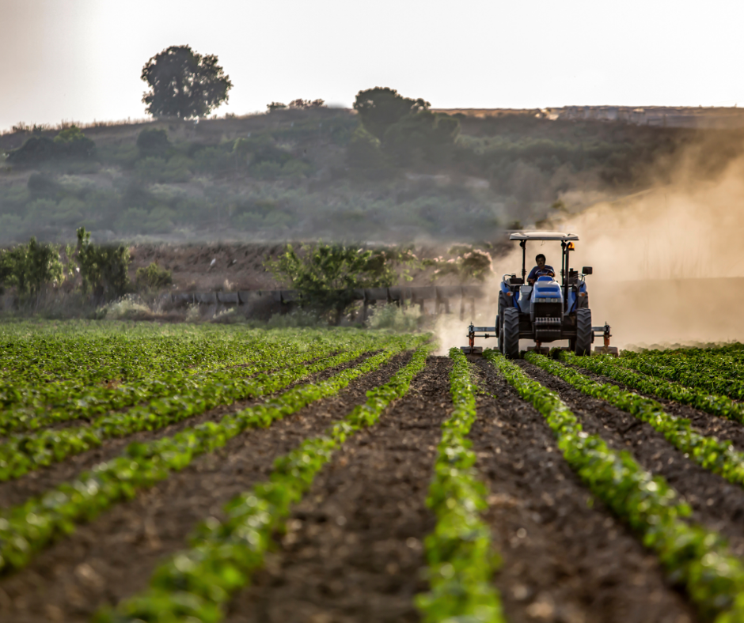
Introduction
Project Dataset
The Project:
The aim is to analyse and predict average temperature from the agri-food sector, using data from the FAO and IPCC, to understand climate impacts and develop sustainable strategies for stakeholders including policymakers and agricultural businesses.
The Dataset:
Multiple features (30+)
~ 7000 records

Slide 5
01.
Introduction
02.
Project Workflow
03.
Conclusion

Slide 6








Project Workflow
Overview of Tools
In this project we would be using the following tools:
Github for versioning and collaboration
Project Environments (Anaconda/VSCode for development)
Trello for Project Management
Google Slides/Canva for Presentations Visuals

Slide 7
Project Workflow
GitHub
GitHub & Git will be used for the project versioning and documentation.
One team member should fork the Project repository and add the other team members as collaborators. Please click here for the Project repository.
Ensure the repository is Private.
Add you facilitator as a collaborator. Your facilitators GitHub User names will be shared in your Project Teams Emails.
Every team member needs to clone the repo, create a branch, and work from there. We will be accessing contributions (commits) to the repository from each member.
You will have to deal with merge conflicts 🙃
Your GitHub repo will need a ReadMe file.
Here is a helpful link to shortcuts in Markdown.

Slide 8
Project Workflow
Python Overview
You will need to include all the packages used in a requirements.txt file in your GitHub repository
In the ReadMe you need to add instructions on how to recreate the environment using Anaconda.
Here are a few helpful links to get you started:
Managing environments
From conda create requirements.txt for pip3
Exporting your conda environment:
conda activate <env>
conda install pip
#get list of packages and pipe to txt file
pip list --format=freeze > requirements.txt

Slide 9
Project Workflow
Team Roles and Collaboration Strategies
Trello
All team members will be required to create a free Trello account. Click here to sign up if you do not have one.
A team member should be assigned Project Manager to manage the Trello board
The Project Manager will be responsible for creating a new board and inviting other team members to join.
They will also be responsible for creating list, cards, assigning tasks, using labels and checklist to keep track of of the project.
You can learn more about how to use Trello to manage this project by watching this video.
Slide Deck
These are tools for creating beautiful engaging slides.

Slide 10
04
Project Timelines - Continued
Project Workflow
Understand the Dataset.
Elect a team lead, project manager (manages trello), and share with your Facilitator.
Set up all other collaborative and development tools required for the project.
Regression _ Week 1
Regression _ Week 2
Submit Team Form / Team Preferences
Get to know your Teammates and Facilitator, and ways of work.
‹#›

Slide 11
Project Workflow
Project Timelines - Continued
Regression _ Week 3
Regression _ Week 4
Perform train-test splits.
Train with a minimum of 3 models.
Explore and decide on Model Evaluation Metrics.
Compare and contrast models performance.
Add all relevant information about the model to the slide deck (Model comparisons, evaluations, and others).
Clean your dataset.
Perform Exploratory Data Analysis on the Dataset.
Begin working on the slide deck.

Slide 12
Project Workflow
Project Timelines - Continued
Regression _ Week 5
Regression _ Week 6
Continuation of Week 4 Deliverables
Complete Deliverables -> Send Completion Email, with all resources/deliverables included.
Submit by Deadline:
Monday, 11 November 2024 @ 11:59 PM CAT
Please note the Regression Exam [MCQ] is due the same day, plan your time carefully!

Slide 13
01.
Introduction
02.
Project Workflow
03.
Conclusion

Slide 14
Conclusion
Key Takeaways
The Project is 6 weeks long.
[Try to complete by week 5 to give time for exam preparation.]
Team size: 5-6 members
You will be all be assigned a team you will work with, by default. Please fill out this form to indicate your preference to work in a team or individually by Thursday, 3 October 2024 @ 15:00.
Deliverables:
Trello for Project Task assignments and the entire project management.
GitHub for collaboration and version control.
Google Slide/Canva for presentation deck.
Jupyter Notebook which should be:
Well formatted to contain all relevant sections
A robust and well annotated EDA.
At least 3 regression models.
A model comparison, selection, and recommendation section.

Slide 15
Conclusion
Important links
Please find below, important links:
Project Repository: Click here
Facilitator Github Usernames: Click here
Managing Environments: Click here
Creating environments from requirements.txt using “conda create”: Click here
Jupyter notebook markdown cheatsheet: Click here
Sign-up to Trello: Click here
Video on how to set-up your Trello board: click here

Slide 16
Welcome to “Learning Machine Learning!”
Any Questions?

